Slide 1
The Resident in Difficulty
Dean Seehusen, MD, MPH
Associate Dean for Graduate Medical Education
Professor of Family Medicine

Slide 2
Defining the Problem

Slide 3
Two Levels of Identification
What is the learner having difficulty with?
Competencies
Milestones
Entrustable Professional Activities
Why is the learner having the difficulty
Cognitive Issues
Non-cognitive issues

Slide 4
What is the learner having difficulty with?
Competencies (or milestones, or entrustable professional activities)
Patient Care
Medical Knowledge
Practice-Based Learning and Improvement
Interpersonal and Communication Skills
Professionalism
Systems-Based Practice
Outside issues
Anything that prevents proper focus on training
Examples: Illness, significant family problems, financial difficulties

Slide 5
Why is the learner having the difficulty?
Cognitive
Insufficient Knowledge
Clinical Reasoning
Non-cognitive
Attitude problems
Affective problems
Boileau E, St-Onge C, Audétat MC. Is there a way for clinical teachers to assist struggling learners? A synthetic review of the literature. Adv Med Educ Pract. 2017 Jan 18;8:89-97.

Slide 6
Underlying Cause?
Category | Underlying Causes (not a comprehensive list)
Insufficient Knowledge | Poor medical school preparation Inadequate personal investment in education Learning disorder
Clinical Reasoning | Knowledge deficit Insufficient practice Executive functioning skills Disorganization
Attitude Problems | Ignorance of professional responsibilities Difference of values and beliefs Poor insight Poor social skills Lack of motivation Personality disorder
Affective Problems | Mood disorders Substance abuse Stress (home, work, financial) Burnout
Boileau E, St-Onge C, Audétat MC. Is there a way for clinical teachers to assist struggling learners? A synthetic review of the literature. Adv Med Educ Pract. 2017 Jan 18;8:89-97.

Slide 7
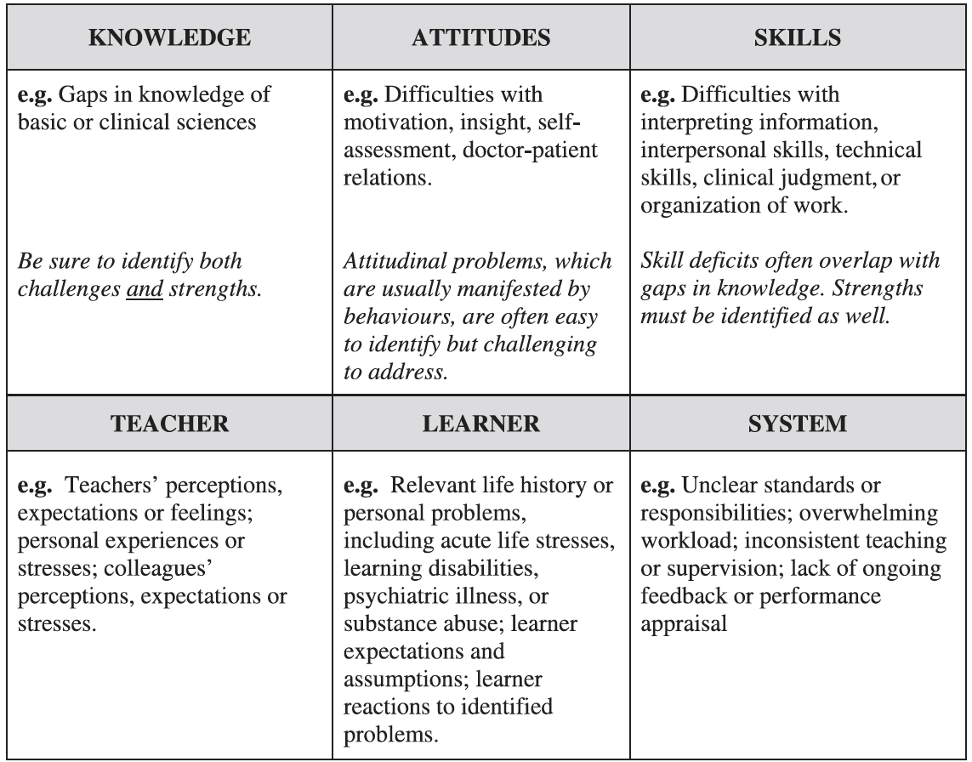
One Alternative Taxonomy
Steinert Y. The "problem" learner: whose problem is it? AMEE Guide No. 76. Med Teach. 2013 Apr;35(4):e1035-45

Slide 8
It’s Not Just the Resident
Resident issues
Cognitive
Non-cognitive
Faculty issues
Personal reaction to resident difficulties
Experience with residents in difficulty
Program / System issues
System difficulties can address stress to residents
System designed around rigid expectations of residents
Steinert Y. The "problem" learner: whose problem is it? AMEE Guide No. 76. Med Teach. 2013 Apr;35(4):e1035-45

Slide 9
Developing a Plan

Slide 10
Keys to successful remediation
Proper diagnosis (what and why)
Look for co-morbidities such as mental illness and substance abuse
Remediation plan based on specifics of the situation
Individual Educational Plan
Given in writing
SMART(ER) objectives
Sets out ramifications of not meeting objectives
Attend to the institution’s due process rules
Maintain a safe and supportive learning environment

Slide 11
Developing a Plan
Ideally created and written with lots of input
PD, APD, Advisor
Input from faculty (CCC)
Input from the resident may increase buy-in
The GME Office
The invisible college
Use SMARTER acronym to develop individual points of the plan

Slide 12
SMARTER Objectives
S- specific
M- measurable
A- achievable
R- relevant
T- time bound
E- engaging
R- re-assessed periodically
MacLeod L. Making SMART goals smarter. Physician Exec. 2012 Mar-Apr;38(2):68-70, 72.

